Slide 1

Dental caries detection using deep learning
Under the Supervision of :
Mr. Sanabam Bineshwor Singh
Department of Computer Science & Engineering
Presented by :
Ramavath Vinod Naik (20103045)
Daniel Lunginlian (20103046)
Catherine Nembiakching (20103057)

Slide 2
CONTENTS
1.INTRODUCTION
2.LITERATURE SURVEY
3.METHODOLOGY
4.YOLOv8
4.1. YOLOv8 Architectute
5.TRAINING BATCH
6.RESULTS
7.FUTURE WORK
8.CONCLUSION
9.REFERENCES

Slide 3
1.INTRODUCTION
In the previous presentation, we provided an overview of the project, delving into topics such as deep learning, convolutional neural networks (CNNs), and the advantages and disadvantages of various methods. In today's presentation, our focus will be on the model selected for caries detection and the partial improvements achieved in recent days:

Slide 4
2.Literature Survey
Andras Horvath et al. (2019) proposed CNN architectures (subpixel network and U-net) for enhancing 2D cone-beam CT image resolution of ex vivo teeth, outperforming reconstruction-based super-resolution methods. Abdolvahab Ehsani Rad et al. (2018) introduced a segmentation methodology using morphological data and neural networks for efficient tooth segmentation, achieving a high detection accuracy of 98%.
Nima Karimian et al. (2018) applied deep CNNs to oral tissue classification in OCT imaging, demonstrating its effectiveness in identifying tissue densities. Olaf Ronneberger et al. (2015) presented a U-shaped CNN model for automatic dental X-ray segmentation with high accuracy in identifying enamel, dentin, and pulp.
Angelino et al. (2017) developed a near-infrared diode imaging system for detecting teeth decay, albeit with accuracy limitations. Joonhyang Choi et al. (2018) reported an automated decay detection system using CNNs and refinement modules, achieving early-stage decay identification.
Shashikant Patil et al. (2019) utilized AI techniques for decay detection, emphasizing the effectiveness of science and neural network algorithms. Laura A Zanell Calzada et al. (2018) proposed a dense artificial neural network for classifying dental subjects, achieving significant accuracy in distinguishing decay presence from absence.
Casalegno et al. (2019) employed a CNN for machine-controlled detection and localization of dental lesions, demonstrating promising results for tooth decay detection. Prajapati et al. (2017) explored CNNs for dental disease classification with encouraging accuracy using a small labeled dataset.
Geetha et al. (2020) developed a diagnostic system using neural networks achieving 97.1% accuracy in tooth decay diagnosis. Moutselos et al. (2019) utilized Mask R-CNN to detect decay on occlusal surfaces across a 7-class scale, discussing potential improvements for better classification.

Slide 5
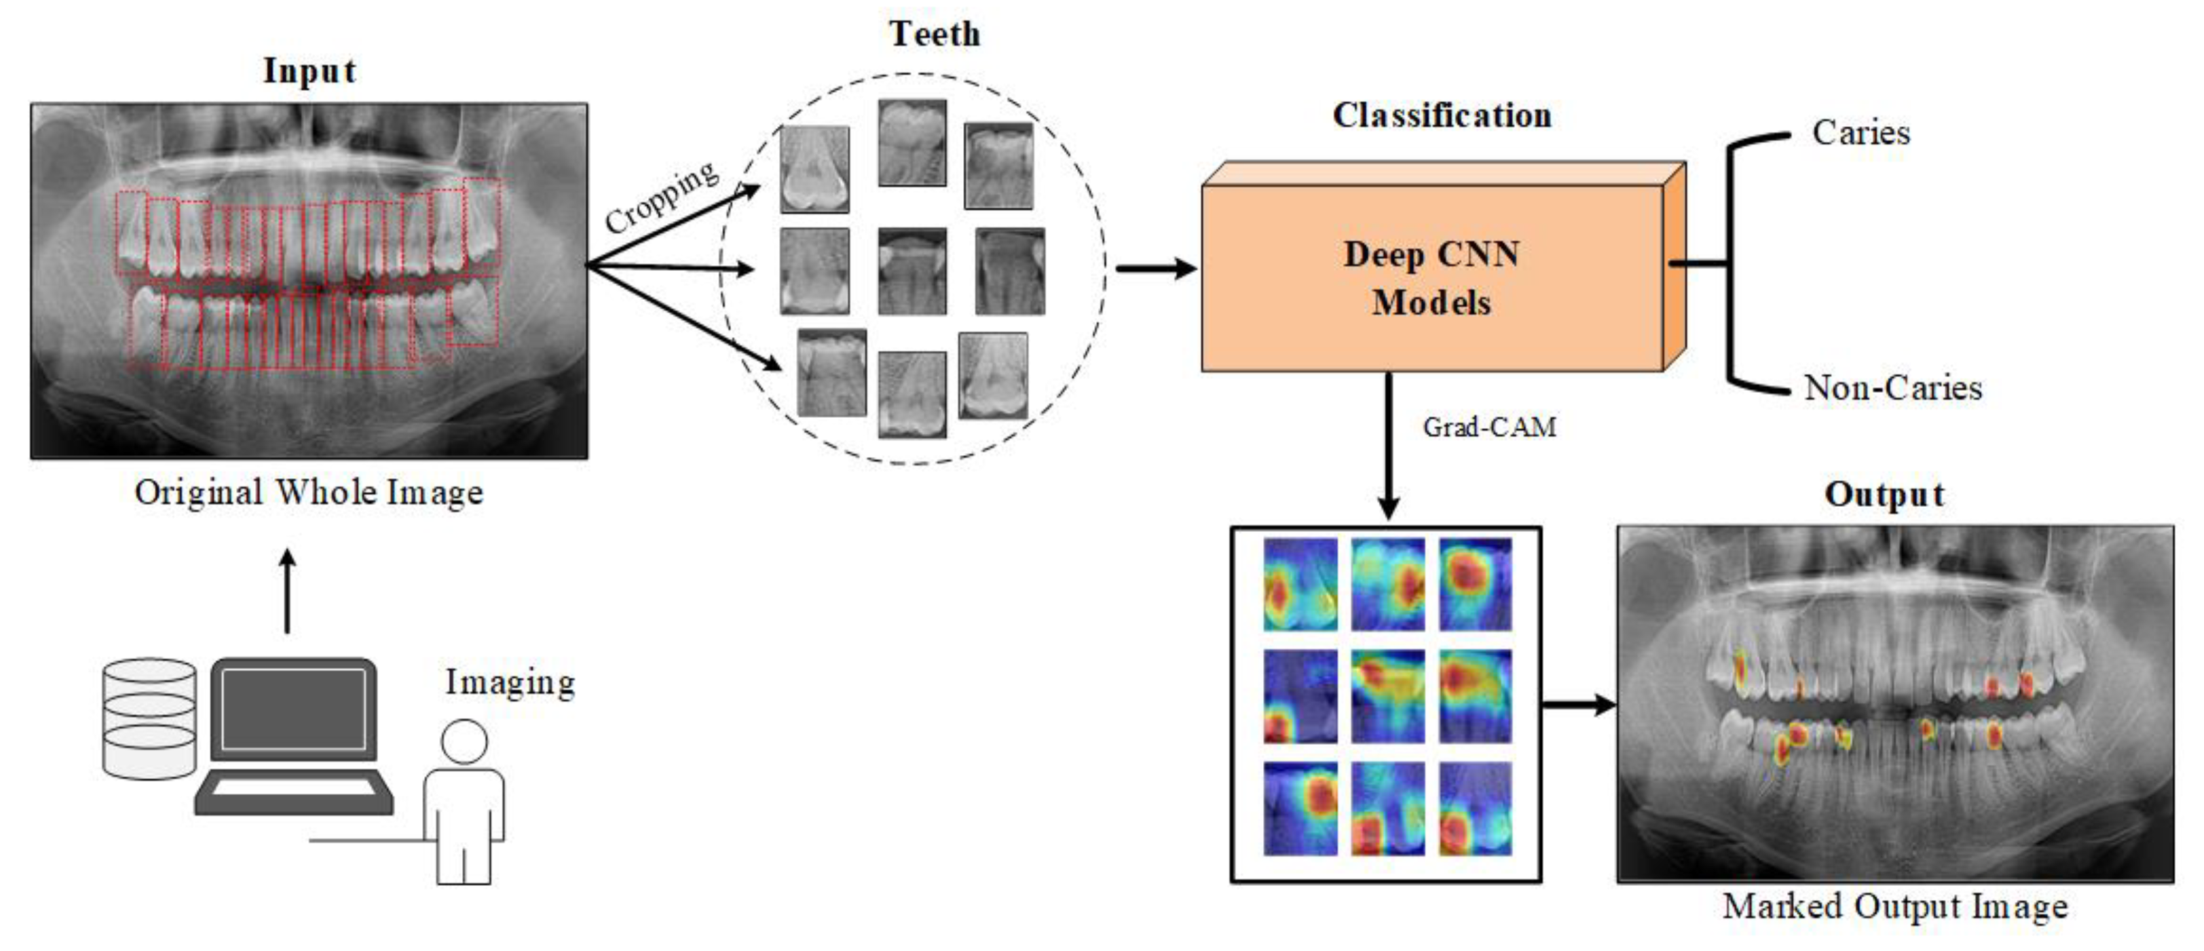
3.METHODOLOGY
Fig5 :Process of Dental caries detection

Slide 6
4.YOLOv8
YOLOv8 is a new state-of-the-art computer vision model built by Ultralytics, the creators of YOLOv5. The YOLOv8 model contains out-of-the-box support for object detection, classification, and segmentation tasks, accessible through a Python package as well as a command line interface.

Slide 7
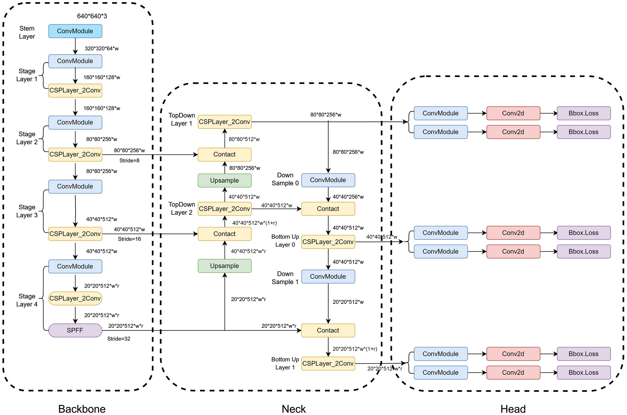
4.1 YOLOv8 Architecture

Slide 8
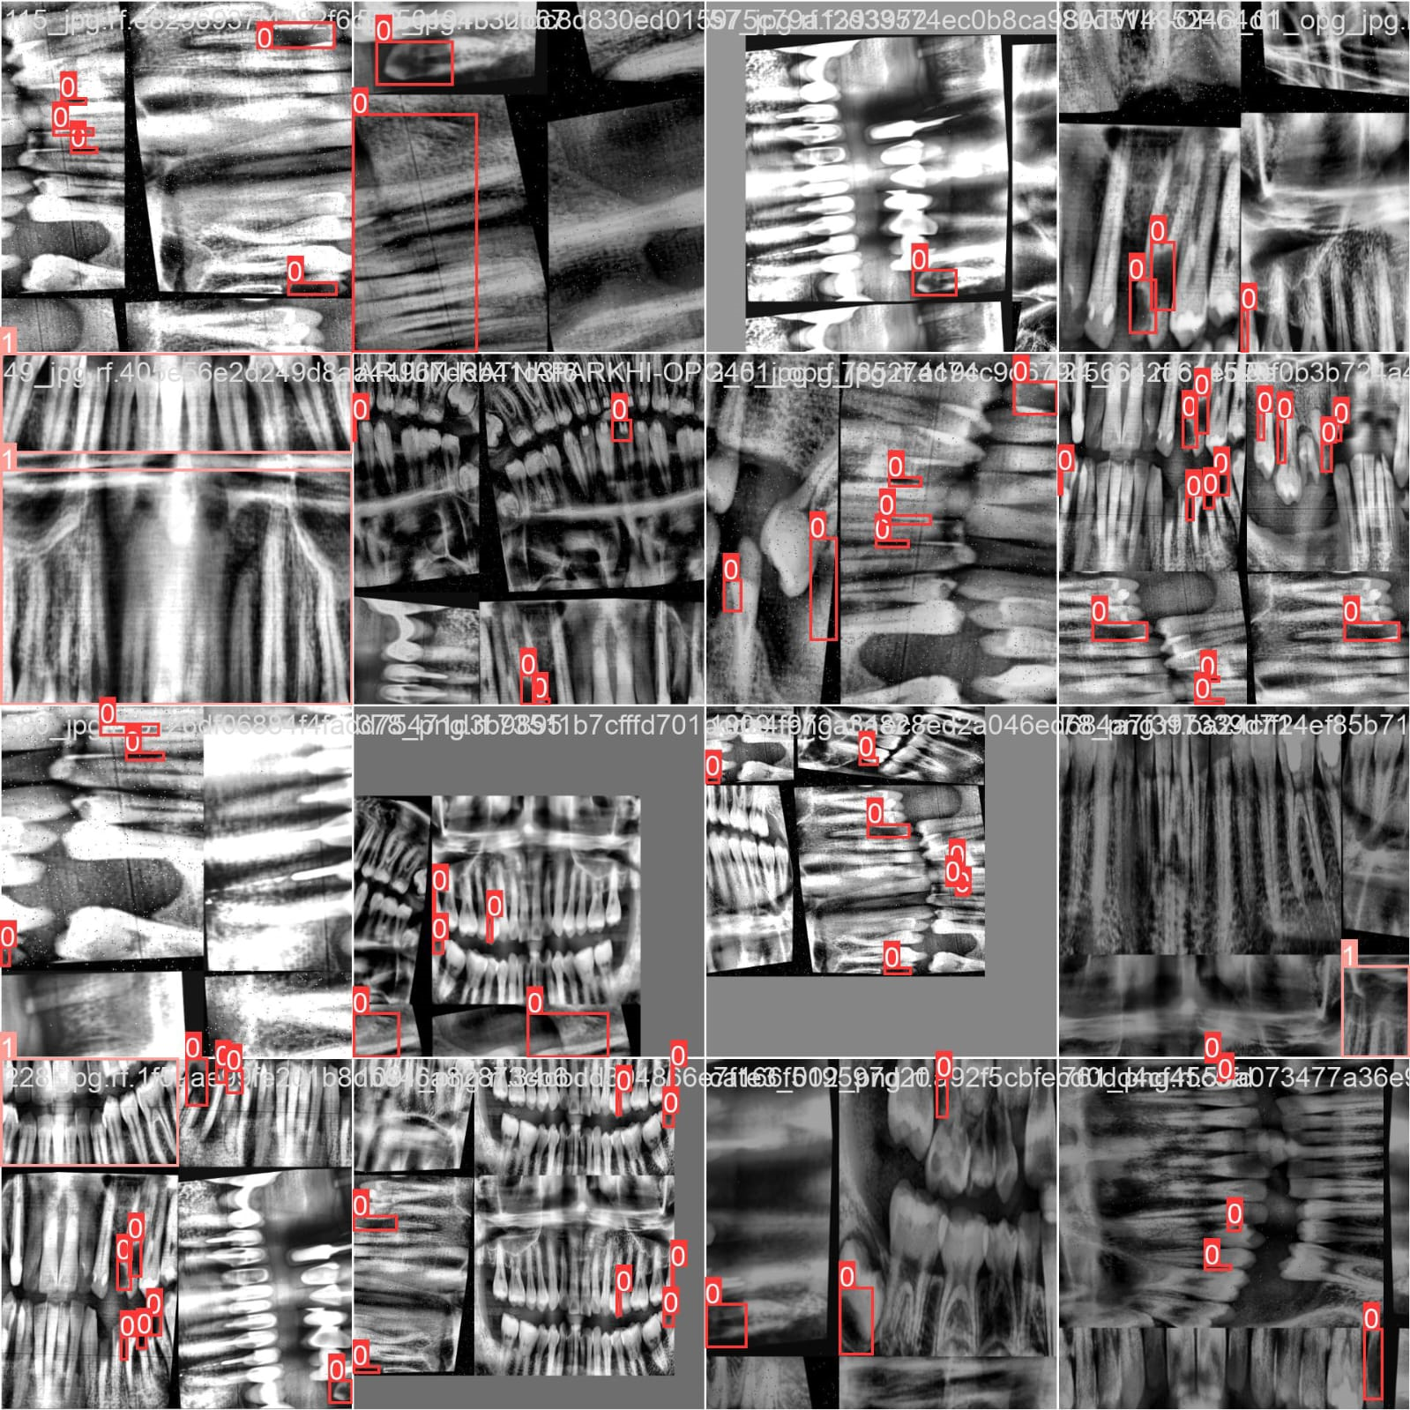
5.TRAINING BATCH

Slide 9
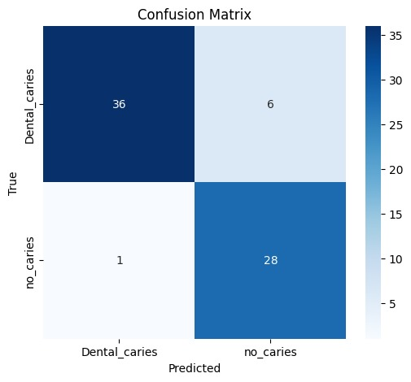
6.RESULT

Slide 10
7. future WORK • Data availability and reliability • Large-Scale Dataset Construction • Fine-Grained Localization and Segmentation • Hybrid approaches • Explainable AI and Interpretability • Continual Learning and Adaptation

Slide 11
8.Conclusion:
The confusion matrix of our dental caries detection model demonstrates its high effectiveness. The model accurately identified a majority of both dental caries and no caries cases, with only a few misclassifications. This indicates its strong potential in reliable dental caries detection.
The model's performance highlights its promise in supporting dental professionals by providing accurate diagnoses. However, efforts to reduce false positives will further enhance its reliability. Continued validation with diverse datasets is essential to ensure robustness and accurate results in clinical practice.
Overall, the model shows promise in aiding dental professionals by improving patient outcomes through timely and effective treatment planning.

Slide 12
9. References:
1. Rimi I.F., Arif M.A.I., Akter S., Rahman M.R., Islam A.H.M.S., Habib M.T. Machine Learning Techniques for Dental Disease Prediction. Iran J. Comput. Sci. 2022;5:187–195. doi: 10.1007/s42044-022-00101-0. [CrossRef] [Google Scholar]
2. Zhang X., Liang Y., Li W., Liu C., Gu D., Sun W., Miao L. Development and Evaluation of Deep Learning for Screening Dental Caries from Oral Photographs. Oral Dis. 2022;28:173–181. doi: 10.1111/odi.13735. [PubMed] [CrossRef] [Google Scholar]

Slide 13
Thank you

